Slide 1
Kacha Bazar . Com A ONLINE SHOPING SYSTEM

Slide 2



Presented by
Md Asaduzzaman Masum
ID :- CSE 06307433
Md Shamim
ID :- CSE 06307456
Toufiq Anam Fahim
ID :- CSE 06307436

Slide 3
Information Gathering & Interview
Goals
Gather opinions or viewpoints
Gather information on the user point of view
Knowing User Needs and Expectation
Understanding the current system
Verification of previously gathered facts

Slide 4

Method of information gathering
Information
Survey Form
Interview
Hints from existed System

Slide 5
Survey Form
Specific Question
Question no. 11

Slide 6
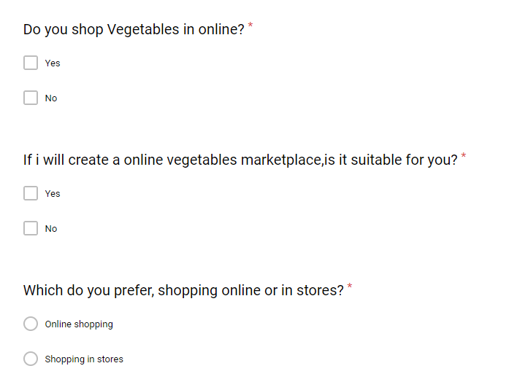
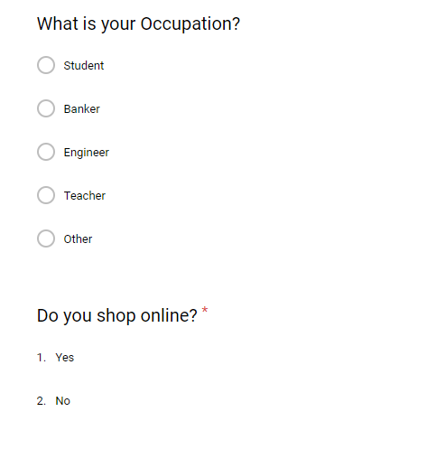
Survey questionnaires

Slide 7
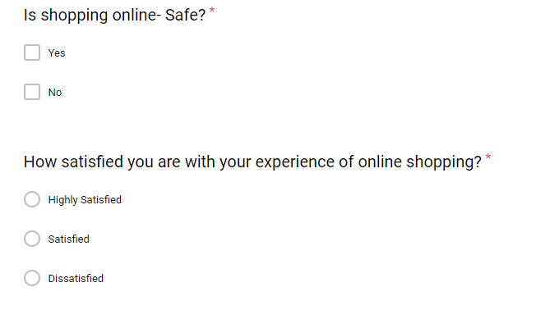
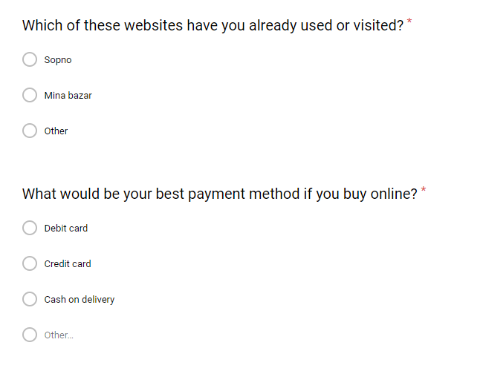
Survey questionnaires

Slide 8
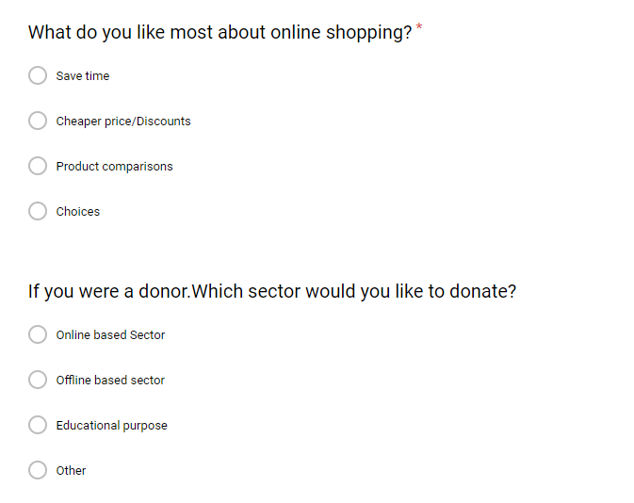
Survey questionnaires

Slide 9
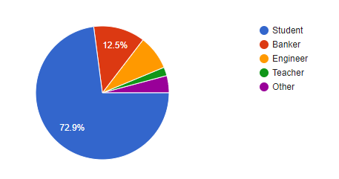
Survey Results
Count of occupation

Slide 10
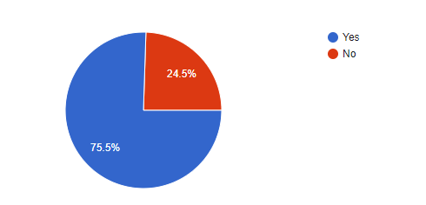
Survey Results
Online shopping percentage

Slide 11
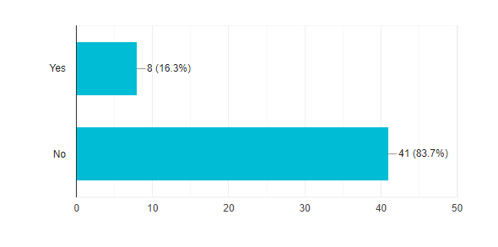
Survey Results
Buying vegetables in online

Slide 12
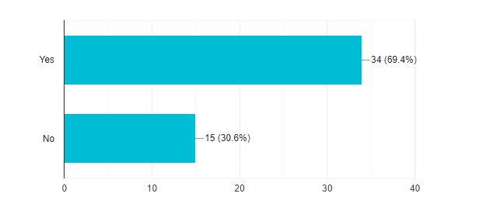
Survey Results
If I will create a online vegetables marketplace, is it suitable?

Slide 13
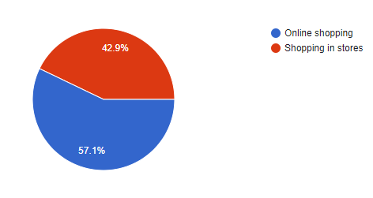
Survey Results
Preference of online shopping or in stores

Slide 14
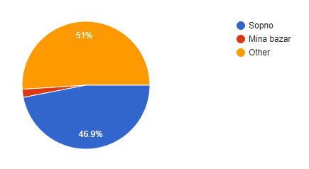
Survey Results
Already visited websites

Slide 15
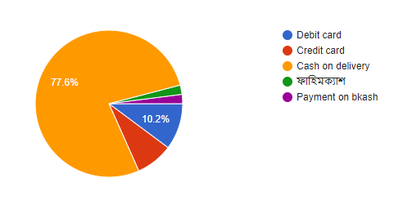
Survey Results
Best payment method

Slide 16
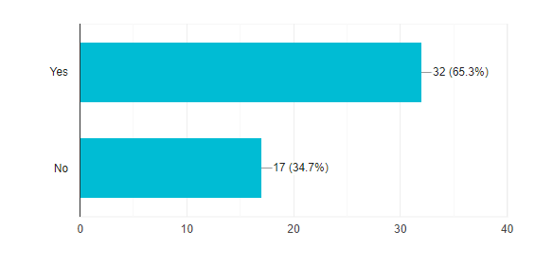
Survey Results
Safety of online shopping

Slide 17
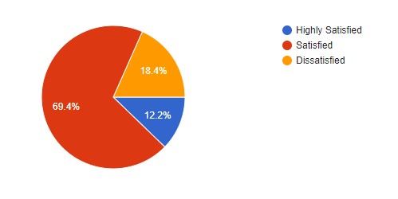
Survey Results
Satisfaction of online shopping

Slide 18
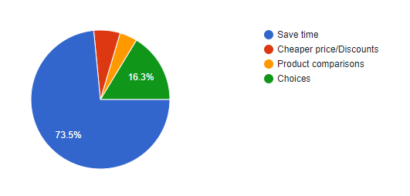
Survey Results
Most likely issues of online shopping to user

Slide 19
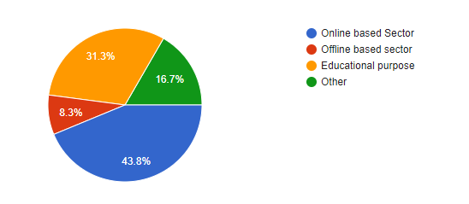
Survey Results
User like to donate

Slide 20
Interview Structure
Open ended question
Close ended question

Slide 21

Interviewee
Md Arif Hosen
Ex-Engineer at Shwapno
Present-Senior officer(ICT) at Agrani Bank
Gmail : ariftiu@gmail.com
Contact no. 01731281711

Slide 22
Interview Question
Question 01: Assalamu Alaykum viyya. How are you?
Answer: Walykum Assalam. Alhamdulillah Fine.
Question 02: How shwapno.com works?
Answer: When a consumer wants to buy a certain product, he go to the website and selects the product he wants to buy. Once the product is selected, the consumer transaction is moved to the online transaction server where he places an order.

Slide 23
Interview Question
Question 03: What kind of products your company sale?
Answer: We use many other product for sales like-
Baby Food and care
Chocolates & Candies
Fruits & Vegetables
Meat & Fish
Household Items & Etc.

Slide 24
Interview Question
Question 04: What are the types of Ecommerce Applications available in the It industry?
Answer:
Business to Business (B2B) Business to Customers (B2C) Customers to Customers (C2C) Customers to Business (C2B) Etc...

Slide 25
Interview Question
Question 05: What Is the Difference Between Business-to-business And Business-to-consumer Electronic Commerce?
Answer: Difference between business-to-business and business-to-consumer e-commerce Business-to-business electronic commerce is conducted between two separate businesses, such as a large company needing office supplies and an office supply company. Business-to-consumer electronic commerce is between one individual and a company selling goods or services.
Question 06: Which procedure use your online user, for payment?
Answer: Our maximum online user use Debit card, Credit card & BKash.

Slide 26
Interview Question
Question 07: How does a user interact with the system?
Answer: It is public process. Anybody can connect with ours going to our website Shwapno.com but yes we are about 600000 registered users. They uses Shwapno with login process. Everyone connect with ours with sign in process.
Question 08: What is your ordering procedure?
Answer: Any contract for the supply of Grocery Delivery from this Website is between you and the corresponding outlets .for the supply or Goods or Services from this website any contact is between you and Shwapno.com .you also warrant that the credit or debit card details that you provide are for your own credit or debit card and that you have sufficient funds to make payment.

Slide 27
Interview Question
Question 09: How Does Web Marketing Create A More Personalized Approach Than Radio Or Television Advertising?
Answer: By allowing users to select the ads they would like to pursue; in radio and television advertising, the viewer or listener is more of a passive recipient of the information.
Question 10: Why Shwapno focused?
Answer: Shwapno was initially focused on the price sensitive customer base, but after years of steady growth of its conventional retail and other channels, the company now serves a diverse market covering many segments.
Question 11: How many people connected with Shwapno?
Answer: 600,000 registered customers, 2500 colleagues, and thousands of suppliers and growers.

Slide 28
Hints from already existed system
A mobile website option
Free or competitive shipping options
A detailed product description
A fast guest check-out option

Slide 29
Summary
Minor changes for feature
Adding suitable option for user
Modify some option

Slide 30

Thank u for having with us?

